Slide 1
Multiple Linear Regression, Geometry, and Residual Analysis
Projection, Degrees of Freedom, Truth + Error, and Linear Model Structure
Built from L7-L11

Slide 2
Goals for Today
Previously we looked at SLR as a rotation of the line until it minimized the residuals
Treated parameters ${\hat{β}}_{0}$ and ${\hat{β}}_{1}$ as tuning knobs
Today we will look at it as a projection from some $n−$dimensional vector onto a space defined by our two parameters
Parameters ${\hat{β}}_{0}$ and ${\hat{β}}_{1}$ form our basis
We can derive SLR without calculus!
Get some insight into Degrees of Freedom (Df)

Slide 3
Linear Algebra Warm-Up
Vector Notation
What they look like in $ℝ^{n}$ space
Vector addition (and subtraction)
Linear combinations of vectors
Dot Products
Projections

Slide 4
Vector Notation
We can write vectors as columns:
And their transposes:

Slide 5
What Vectors look like in $ℝ^{n}$ Space
$Y=\left[\begin{matrix}y_{1} \\ y_{2}\end{matrix}\right]$
$$y_{2}$$
$$y_{1}$$

Slide 6
What Vectors look like in $ℝ^{n}$ Space
$$y_{3}$$
$Y=\left[\begin{matrix}y_{1} \\ y_{2} \\ y_{3}\end{matrix}\right]$
$$y_{2}$$
$$y_{1}$$

Slide 7
Vector addition (and subtraction)
If we add two vectors:
Subtraction:
$$y_{2}$$
$$y_{1}$$

Slide 8
Linear combinations of vectors
What do I mean by “linear combinations”?
$$y_{2}$$
$$y_{1}$$

Slide 9
Matrix Notation
A matrix has $r$rows and $c$ columns.
Is addition/subtraction commutative?
What about multiplication?

Slide 10
Dot Products and their properties
Formulas:

Slide 11
Projections
We can project a vector onto another vector:

Slide 12
The Linear Regression Problem
We have $n$ data points, $\left(x_{1},y_{1}\right),\left(x_{2},y_{2}\right),…,(x_{n},y_{n})$
We want to draw the “best” line through them but we are overdetermined.

Slide 13
The Linear Regression Problem
We have $3$ data points, $\left(x_{1},y_{1}\right),\left(x_{2},y_{2}\right),(x_{3},y_{3})$
We want to draw the “best” line through them but we are still overdetermined.

Slide 14
The Linear Regression Problem
We can write $n$ (3 in this example) equations with 2 unknowns:
$$y_{1}=β_{0}+β_{1}x_{1}$$
$$y_{2}=β_{0}+β_{1}x_{2}$$
$$y_{3}=β_{0}+β_{1}x_{3}$$
Since we are overdetermined, we (most likely) don’t have a single solution for $β_{0}$ and $β_{1}$.
$$\left(x_{3},y_{3}\right)$$
$$\left(x_{1},y_{1}\right)$$
$$\left(x_{2},y_{2}\right)$$

Slide 15
Linear Regression (This Time, Using Linear Algebra)
We can use projection as a tool to find ${\hat{β}}_{0}$ and ${\hat{β}}_{1}$ to estimate $β_{0}$ and $β_{1}$.
$$y_{1}=β_{0}+β_{1}x_{1}$$
$$y_{2}=β_{0}+β_{1}x_{2}$$
$$y_{3}=β_{0}+β_{1}x_{3}$$
$$\left(x_{3},y_{3}\right)$$
$$\left(x_{1},y_{1}\right)$$
$$\left(x_{2},y_{2}\right)$$

Slide 16
Rewriting our 3 Equations in Vector Notation
$$\left[\begin{matrix}y_{1} \\ y_{2} \\ y_{3}\end{matrix}\right]=\left[\begin{matrix}β_{0} \\ β_{0} \\ β_{0}\end{matrix}\right]+\left[\begin{matrix}β_{1}x_{1} \\ β_{1}x_{2} \\ β_{1}x_{3}\end{matrix}\right]$$

Slide 17
Drawing them in 3D space
$$Y$$
$$\left[\begin{matrix}y_{1} \\ y_{2} \\ y_{3}\end{matrix}\right]=β_{0}\left[\begin{matrix}1 \\ 1 \\ 1\end{matrix}\right]+β_{1}\left[\begin{matrix}x_{1} \\ x_{2} \\ x_{3}\end{matrix}\right]$$
$$1$$
$$X$$

Slide 18
Drawing them in 3D space
$$Y$$
$x$ and $1$ span a 2D plane.
We can write any vector on that plane as a linear combination of the vectors $x$ and $1$.
$$1$$
$$x$$

Slide 19
Linear Solution
In a perfect world, $Y$ would lie on that plane.
$$\left(x_{3},y_{3}\right)$$
$$\left(x_{2},y_{2}\right)$$
$$\left(x_{1},y_{1}\right)$$
$$Y$$
$$1$$
$$x$$

Slide 20
Linear Regression
But it doesn’t. So we need to project it down onto our plane.
$$Y$$
$$\left(x_{3},y_{3}\right)$$
$$\left(x_{1},y_{1}\right)$$
$$\left(x_{2},y_{2}\right)$$
$$1$$
$$x$$

Slide 21
Linear Regression
Then we choose $β_{0}$ and $β_{1}$ that define $\hat{Y}$ as a vector on the $x, 1$ plane.
$$Y$$
$$\hat{Y}$$
$$1$$
$$x$$

Slide 22
Rewriting our 3 Equations in Vector Notation… again
Since the three data points defined by
$$y_{1}=β_{0}+β_{1}x_{1}$$
$$y_{2}=β_{0}+β_{1}x_{2}$$
$$y_{3}=β_{0}+β_{1}x_{3}$$
don’t perfectly line up, we introduce that error term:
$$Y=β_{0}+β_{1}x+ε$$

Slide 23
Linear Regression
$$Y−\hat{Y}=ε$$
$$Y$$
$$\hat{Y}$$
$$1$$
$$x$$

Slide 24
Linear Regression as a Projection
Thus, we need an Orthogonal Projection to get us to our $\hat{Y}$ from $Y$.
$$Y$$
$$\hat{Y}$$
$$1$$
$$x$$

Slide 25
Solving for $β_{0}$ and $β_{1}$.
We use the properties of orthogonality and the dot product to write:
$$\left(Y−\hat{Y}\right)⋅1=0$$
$$\left(Y−\hat{Y}\right)⋅x=0$$

Slide 26
Solving for $β_{0}$ and $β_{1}$.
A little manipulation:
$$Y⋅1−\hat{Y}⋅1=0$$
$$Y⋅x−\hat{Y}⋅x=0$$

Slide 27
Solving for $β_{0}$ and $β_{1}$.
A little manipulation:
$$Y⋅1=\hat{Y}⋅1$$
$$Y⋅x=\hat{Y}⋅x$$

Slide 28
Solving for $β_{0}$ and $β_{1}$.
Since dot products are commutative:
$$1⋅Y=1⋅\hat{Y}$$
$$x⋅Y=x⋅\hat{Y}$$

Slide 29
Solving for $β_{0}$ and $β_{1}$.
Swapping sides:
$$1⋅\hat{Y}=1⋅Y$$
$$x⋅\hat{Y}=x⋅Y$$

Slide 30
Solving for $β_{0}$ and $β_{1}$.
Substituting $\hat{Y}={\hat{β}}_{0}1+{\hat{β}}_{1}X$:
$$1⋅\hat{Y}=1⋅Y$$
$$x⋅\hat{Y}=x⋅Y$$

Slide 31
Solving for $β_{0}$ and $β_{1}$.
Then we can distribute:
$$1⋅\left({\hat{β}}_{0}1+{\hat{β}}_{1}x\right)=1⋅Y$$
$$x⋅({\hat{β}}_{0}1+{\hat{β}}_{1}x)=x⋅Y$$

Slide 32
Solving for $β_{0}$ and $β_{1}$.
And then rewrite this in matrix notation:
$${\hat{β}}_{0}1⋅1+{\hat{β}}_{1}1⋅x=1⋅Y$$
$${\hat{β}}_{0}x⋅1+{\hat{β}}_{1}x⋅x=x⋅Y$$

Slide 33
Solving for $β_{0}$ and $β_{1}$.
Then rewriting the dot products using transpose notation:
$${\hat{β}}_{0}1⋅1+{\hat{β}}_{1}1⋅x=1⋅Y$$
$${\hat{β}}_{0}x⋅1+{\hat{β}}_{1}x⋅x=x⋅Y$$
$$⇒ \left[\begin{matrix}1⋅1 & 1⋅x \\ x⋅1 & x⋅x\end{matrix}\right]\left[\begin{matrix}{\hat{β}}_{0} \\ {\hat{β}}_{1}\end{matrix}\right]=\left[\begin{matrix}1⋅Y \\ x⋅Y\end{matrix}\right]$$

Slide 34
Solving for $β_{0}$ and $β_{1}$.
Now we can decompose:
$$\left[\begin{matrix}1⋅1 & 1⋅x \\ x⋅1 & x⋅x\end{matrix}\right]\left[\begin{matrix}{\hat{β}}_{0} \\ {\hat{β}}_{1}\end{matrix}\right]=\left[\begin{matrix}1⋅Y \\ x⋅Y\end{matrix}\right]$$
$$⇒ \left[\begin{matrix}1^{T}1 & 1^{T}x \\ x^{T}1 & x^{T}x\end{matrix}\right]\left[\begin{matrix}{\hat{β}}_{0} \\ {\hat{β}}_{1}\end{matrix}\right]=\left[\begin{matrix}1^{T}Y \\ x^{T}Y\end{matrix}\right]$$

Slide 35
Solving for $β_{0}$ and $β_{1}$.
Now we can decompose:
$$\left[\begin{matrix}1^{T}1 & 1^{T}x \\ x^{T}1 & x^{T}x\end{matrix}\right]\left[\begin{matrix}{\hat{β}}_{0} \\ {\hat{β}}_{1}\end{matrix}\right]=\left[\begin{matrix}1^{T}Y \\ x^{T}Y\end{matrix}\right]$$
$$⇒ \left[\begin{matrix}1^{T} \\ x^{T}\end{matrix}\right]\left[\begin{matrix}1 & x\end{matrix}\right] \left[\begin{matrix}{\hat{β}}_{0} \\ {\hat{β}}_{1}\end{matrix}\right]=\left[\begin{matrix}1^{T} \\ x^{T}\end{matrix}\right]Y$$

Slide 36
The Design Matrix
We define the design matrix $X:$
$$X≔[\begin{matrix}1 & x\end{matrix}]$$
$$X=\left[\begin{matrix}1 & x_{1} \\ 1 & x_{2} \\ 1 & x_{3}\end{matrix}\right]$$
using our three data point example.

Slide 37
The Design Matrix
More generally:
$$X≔[\begin{matrix}1 & x\end{matrix}]$$
$$X=\left[\begin{matrix}1 & x_{1} \\ 1 & x_{2} \\ ⋮ & ⋮ \\ 1 & x_{n}\end{matrix}\right]$$
for $n$ observations. (It is harder to draw $ℝ^{n}$ space).

Slide 38
The Design Matrix
The column space of $X$ is a 2-dimensional plane (subspace) in $ℝ^{n}$.
$$Y$$
$$\hat{Y}$$
$$1$$
$$x$$

Slide 39
The Design Matrix
The design matrix
$$X≔[\begin{matrix}1 & x\end{matrix}]$$
is the same that we saw in Python and statsmodels. We will see it again.

Slide 40
Back to Solving for $β_{0}$ and $β_{1}$.
So we can insert our design matrix $X$:
$$\left[\begin{matrix}1^{T} \\ x^{T}\end{matrix}\right]\left[\begin{matrix}1 & x\end{matrix}\right] \left[\begin{matrix}{\hat{β}}_{0} \\ {\hat{β}}_{1}\end{matrix}\right]=\left[\begin{matrix}1^{T} \\ x^{T}\end{matrix}\right]Y$$
$$X^{T}X\left[\begin{matrix}{\hat{β}}_{0} \\ {\hat{β}}_{1}\end{matrix}\right]=X^{T}Y$$

Slide 41
Back to Solving for $β_{0}$ and $β_{1}$.
Now we isolate $β_{0}$ and $β_{1}$:
$$X^{T}X\left[\begin{matrix}{\hat{β}}_{0} \\ {\hat{β}}_{1}\end{matrix}\right]=X^{T}Y$$
$$\left[\begin{matrix}{\hat{β}}_{0} \\ {\hat{β}}_{1}\end{matrix}\right]={\left(X^{T}X\right)}^{−1}X^{T}Y$$

Slide 42
The Hat Matrix
We have just shown that $\left[\begin{matrix}{\hat{β}}_{0} \\ {\hat{β}}_{1}\end{matrix}\right]={\left(X^{T}X\right)}^{−1}X^{T}Y$.
How can we write the predicted values, $\hat{Y}$, in terms of $\hat{β}$= $\left[\begin{matrix}{\hat{β}}_{0} \\ {\hat{β}}_{1}\end{matrix}\right]$?
$$\hat{Y}=X\hat{β}=X{\left(X^{T}X\right)}^{−1}X^{T}Y$$
We denote the matrix $X{\left(X^{T}X\right)}^{−1}X^{T}$ by $H$. It is called the hat matrix.
Why?

Slide 43
Properties of the Hat Matrix
$$H≔X{\left(X^{T}X\right)}^{−1}X^{T}$$
The matrix $H$ has the following properties:
Symmetry:
$$H^{T}=H$$
Idempotent:
$$H^{2}=H$$
Influence:
$$\frac{∂{\hat{y}}_{i}}{∂y_{j}}=H_{i,j}$$
A matrix that satisfies (1) and (2) is called an orthogonal projection.

Slide 44
Properties of the Hat Matrix
A matrix that satisfies (1) and (2) is called an orthogonal projection.
Thus, $\hat{Y}=HY$ is the orthogonal projection of $Y$onto $\hat{Y},$ which lies on the $1,x$ plane.
$$Y$$
$$\hat{Y}$$
$$1$$
$$x$$

Slide 45
Takeaways
We just showed that simple linear regression, when written in matrix form, is a projection from the space of $n$ observations onto a subspace (plane) of $p+1=2$ parameters.
orthogonal projection $⇒$ least squares estimator
Why do we care?

Slide 46
The Design Matrix
The design matrix
$$X≔[\begin{matrix}1 & x\end{matrix}]$$
can be generalized:
$$X≔[\begin{matrix}1 & x_{1} & … & x_{p}\end{matrix}]$$
for $p$ predictor (input) variables.

Slide 47
The Design Matrix
$$X≔[\begin{matrix}1 & x_{1} & … & x_{p}\end{matrix}]$$
Hence, we can solve for $p+1$ parameters:
$$\hat{β}=\left[\begin{matrix}{\hat{β}}_{0} \\ {\hat{β}}_{1} \\ ⋮ \\ {\hat{β}}_{p}\end{matrix}\right]$$

Slide 48
Et Voilá
We have Multiple Linear Regression!
$$\hat{Y}=HY$$
(without multivariable calculus).
If $X$ has $p$ predictors, the fitted subspace has dimension $p+1$
The residual space has dimension $n−p−1$.

Slide 49
Linear Regression as a Projection
Thus, we need an Orthogonal Projection to get us to our $\hat{Y}$ from $Y$.
$$Y$$
$$\hat{Y}$$
$$1$$
$$x$$

Slide 50
The Design Matrix for SLR.
$$X≔[\begin{matrix}1 & x\end{matrix}]$$
$$X=\left[\begin{matrix}1 & x_{1} \\ 1 & x_{2} \\ ⋮ & ⋮ \\ 1 & x_{n}\end{matrix}\right]$$
for $n$ observations. What are its dimensions?

Slide 51
The Hat Matrix
We showed that $\left[\begin{matrix}{\hat{β}}_{0} \\ {\hat{β}}_{1}\end{matrix}\right]={\left(X^{T}X\right)}^{−1}X^{T}Y$.
We write the predicted (projected), $\hat{Y}$, in terms of $\hat{β}$= $\left[\begin{matrix}{\hat{β}}_{0} \\ {\hat{β}}_{1}\end{matrix}\right]:$
$$\hat{Y}=X\hat{β}=X{\left(X^{T}X\right)}^{−1}X^{T}Y$$
The matrix $X{\left(X^{T}X\right)}^{−1}X^{T}$ is so important that it gets its own name. It is called the hat matrix and we denote it by $H.$

Slide 52
Properties of the Hat Matrix
$$H≔X{\left(X^{T}X\right)}^{−1}X^{T}$$
The matrix $H$ has the following properties:
Symmetry:
$$H^{T}=H$$
Idempotent:
$$H^{2}=H$$
Influence:
$$\frac{∂{\hat{y}}_{i}}{∂y_{j}}=H_{i,j}$$
A matrix that satisfies (1) and (2) is called an orthogonal projection.

Slide 53
Properties of the Hat Matrix
A matrix that satisfies (1) and (2) is called an orthogonal projection.
Thus, $\hat{Y}=HY$ is the orthogonal projection of $Y$onto $\hat{Y},$ which lies on the $1,x$ plane.
$$Y$$
$$1$$
$$x$$
$$\hat{Y}$$

Slide 54
Let’s Show that $H$ is Symmetric: $H^{T}=H$
$$H≔X{\left(X^{T}X\right)}^{−1}X^{T}$$

Slide 55
Let’s Show that $H$ is Idempotent: $H^{2}=H$
$$H≔X{\left(X^{T}X\right)}^{−1}X^{T}$$

Slide 56
Why Do We Care About Idempotence?
It guarantees that $\hat{Y}$ is the projection that was optimal.
$$H\hat{Y}=$$

Slide 57
The Design Matrix in MLR
The design matrix
$$X≔[\begin{matrix}1 & x\end{matrix}]$$
can be generalized:
$$X≔[\begin{matrix}1 & x_{1} & … & x_{p}\end{matrix}]$$
for $p$ predictor (input) variables. What are its dimensions?

Slide 58
The Design Matrix
$$X≔[\begin{matrix}1 & x_{1} & … & x_{p}\end{matrix}]$$
Hence, we can solve for $p+1$ parameters:
$$\hat{β}=\left[\begin{matrix}{\hat{β}}_{0} \\ {\hat{β}}_{1} \\ ⋮ \\ {\hat{β}}_{p}\end{matrix}\right]$$

Slide 59
Multiple Linear Regression
In SLR, we examined the effect of a single variable $x$ on $Y$.
In MLR, we look at the relationships between multiple input variables $x_{i}$ and their effect on $Y$.
In the linear algebra environment, this means selecting which columns of data $x_{1},…,x_{p}$ to include in our design matrix $X$ to multiply with the data $y$ that gives us the estimates for $β_{0}$ and $β_{1}$.
Alternatively, we choose the columns to comprise our design matrix which, through matrix multiplication, becomes the $H$ that puts the hat on $\hat{Y}.$

Slide 60
What are Degrees of Freedom Anyways?
How have you heard this defined as?
Df =

Slide 61
Decomposing a Data Vector
Suppose we have two observations, shown as a vector of data $Y$.
$$Y=\left[\begin{matrix}y_{1} \\ y_{2}\end{matrix}\right]$$
You can’t stop me from adding and subtracting the sample mean.

Slide 62
Decomposing a Data Vector
You can’t stop me from adding and subtracting the sample mean:
$$Y=\left[\begin{matrix}y_{1} \\ y_{2}\end{matrix}\right]=\left[\begin{matrix}y_{1}−\overline{y}+\overline{y} \\ y_{2}−\overline{y}+\overline{y}\end{matrix}\right]$$

Slide 63
Decomposing a Data Vector
And this decomposes into a residual vector and a sample mean vector.
$$Y=\left[\begin{matrix}y_{1} \\ y_{2}\end{matrix}\right]=\left[\begin{matrix}y_{1}−\overline{y} \\ y_{2}−\overline{y}\end{matrix}\right]+\left[\begin{matrix}\overline{y} \\ \overline{y}\end{matrix}\right]$$

Slide 64
Decomposing a Data Vector
Since the original sample size is 2, $Y$ itself has 2 degrees of freedom.
$$Y=\left[\begin{matrix}y_{1} \\ y_{2}\end{matrix}\right]=\left[\begin{matrix}y_{1}−\overline{y} \\ y_{2}−\overline{y}\end{matrix}\right]+\overline{y}\left[\begin{matrix}1 \\ 1\end{matrix}\right]$$

Slide 65
Decomposing a Data Vector
$Y=\left[\begin{matrix}y_{1} \\ y_{2}\end{matrix}\right]=\left[\begin{matrix}y_{1}−\overline{y} \\ y_{2}−\overline{y}\end{matrix}\right]+\overline{y}\left[\begin{matrix}1 \\ 1\end{matrix}\right]$
$$y_{2}$$
$$y_{1}$$

Slide 66
Decomposing a Data Vector
$Y=\left[\begin{matrix}y_{1} \\ y_{2}\end{matrix}\right]=\left[\begin{matrix}y_{1}−\overline{y} \\ y_{2}−\overline{y}\end{matrix}\right]+\overline{y}\left[\begin{matrix}1 \\ 1\end{matrix}\right]$
The residual variation must lie on the residual vector.
$$y_{2}$$
$$y_{1}$$

Slide 67
Decomposing a Data Vector
$$y_{3}$$
$Y=\left[\begin{matrix}y_{1} \\ y_{2} \\ y_{2}\end{matrix}\right]=\left[\begin{matrix}y_{1}−\overline{y} \\ y_{2}−\overline{y} \\ y_{3}−\overline{y}\end{matrix}\right]+\overline{y}\left[\begin{matrix}1 \\ 1 \\ 1\end{matrix}\right]$
We’ll demo this more clearly in desmos.
$$y_{2}$$
$$y_{1}$$

Slide 68
The Design Matrix $X$ and Degrees of Freedom
Regression decomposes $ℝ^{n}$ into two pieces:
The subspace spanned by the design matrix $X$, and
The subspace of the where the residuals live
(1) and (2) are orthogonal complements. Every vector in (1) is orthogonal to every vector (the residuals) in (2).

Slide 69
The “Big 4” Subspaces
Many linear algebraists (particularly Gilbert Strang) refer to four subspaces. We look at these for $X$:
Strang’s Subspace | Regression Meaning | Dimension
Column space of $X$ | Fitted values $\hat{y}$ | $$p+1$$
Left null space of $X$ (null space of $X^{T}$) | Residuals $e=y−\hat{y}$ (Remember, these estimate $ε)$ | $$n−p−1$$
Row space of $X$ | Linear constraints on $β$ | $$p+1$$
Null space of $X$ | Non-identifiable directions (multicollinearity) | varies
*See Linear Algebra and Its Applications by Gilbert Strang, as well as his MIT Open Courseware Videos for more.

Slide 70
Degrees of Freedom as Leftover Dimensions
Sample mean: We started with $n$ observations, and $n$ degrees of freedom.
Estimating the mean constrains the data on a 1-dimensional subspace.
The remaining variation (residuals) live in an ($n−1)$ dimensional orthogonal complement.
This is why the sample variance divides by $n−1$! (This is Df).
SLR: 2 parameters $→$2 degrees of freedom
Design matrix: $n × 2$
Fitted values lie in a 2-dimensional plane, which is a subspace of $ℝ^{n}$.
Residuals live in the orthogonal complement: Dimension $n−2$.
MLR: $p+1$ parameters $→n−p−1$ degrees of freedom
Design matrix: $n × (p+1)$
Fitted values lie in $\left(p+1\right)$-dimensional subspace (a hyperplane).
Residuals live in an $(n−p−1)$-dimensional orthogonal complement.
This is why the denominator of the F-test uses $(n−p−1)$ degrees of freedom.

Slide 71
Identifiability
We had shown
$${\hat{β}=\left(X^{T}X\right)}^{−1}X^{T}Y$$
There is a unique least-squares estimated regression coefficient $\hat{β}$ provided that the determinant of $X^{T}X$ is not zero. What does this mean?
When does $\det\left(X^{T}X\right)=0$ happen?
When columns of $X$ are linearly dependent. What does this mean?
In this case, there is an infinite number of least-squares solutions and we say $\hat{β}$ is not identified.

Slide 72
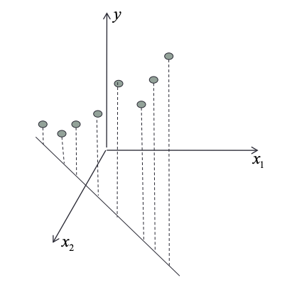
Non-Identifiability Example
Suppose we have:
$x_{1}:$ temperature measured in $℃$
$x_{2}:$ temperature measured in $℉$ $$→x_{2}=\frac{9}{5}x_{1}+32$$
$X=\left[\begin{matrix}1 & x_{1} & x_{2} \\ ⋮ & ⋮ & ⋮ \\ 1 & ⋮ & ⋮\end{matrix}\right]$??

Slide 73
Multiple Linear Regression
Simple Linear Regression (SLR)
$$Y=Xβ+ε$$
Multiple Linear Regression (MLR)
$$Y=Xβ+ε$$
For our assumptions on $ε$.
Where $X$ is the design matrix and $β$ is the vector of coefficients.

Slide 74
What is Different?
In Multiple Linear Regression, we can have multiple predictors.
Tradeoff:
Graphics are difficult in higher dimensions.
Least squares fit is now a (hyper) plane instead of a line.

Slide 75
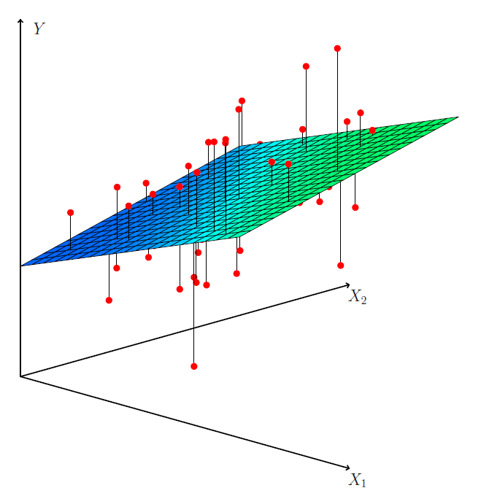
What is Different?
Least squares fit is now a (hyper) plane instead of a line.
Source: ISLP Figure 3.4

Slide 76
Let’s Look at a Dataset
Advertising.csv
Contains data on
(Selected) Response Variable: Sales thousands of units
Predictors are advertising budgets: TV thousands of dollars Radio thousands of dollars Nespaper thousands of dollars
200 different markets.

Slide 77
Some Important Questions
Is at least one of the predictors (TV, Radio, Newspaper) useful in predicting the response (Sales)?
Do all of the predictors help to explain Sales, or is only a subset of predictors useful?
How well does the model fit the data?
Given a set of predictor values, what response value should we predict for Sales, and how accurate is our prediction?

Slide 78
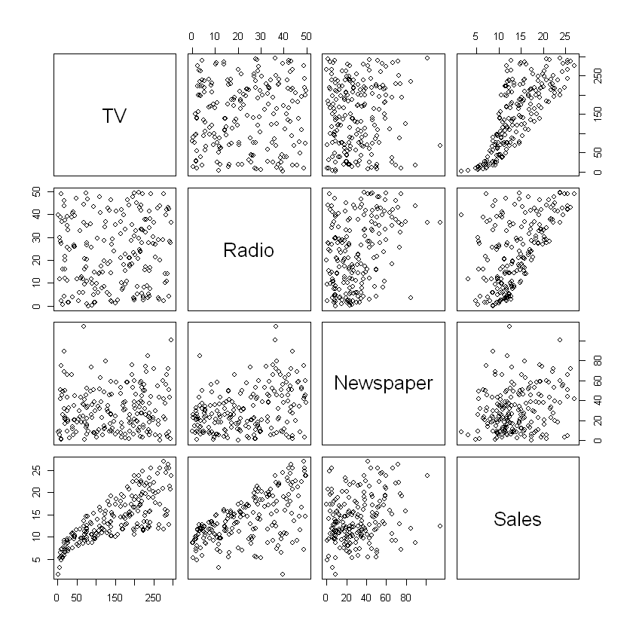
Scatterplot Matrix

Slide 79
Things to Note
Which predictors have the strongest correlation with Sales?
Which predictors have the strongest correlation with each other?

Slide 80
Truth + Error Representation
Why we are diving back into theory here:
Understanding the theoretical behavior of $β$and $ε$ allows us to analyze $\hat{β}$ and ${e=[e}_{i}], i∈1…n$, so we can make meaningful inference about what the data may or may not be telling us.
Up until now, we have vaguely referred to assumptions about the data. We want a way to be able to verify (test hypotheses) what is true with some level of confidence.

Slide 81
Truth + Error Representation
If we fix the design matrix $X$and let $Y$ vary randomly,
Where does the randomness come from?
$$Y=Xβ+ε$$

Slide 82
Truth + Error Representation
If we fix the design matrix $X$and let $Y$ vary randomly,
Where does the randomness come from?
$$Y=Xβ+ε$$
Yes. From $ε$, where $ε$ is a $n × 1$ random vector of noise terms.

Slide 83
Truth + Error Representation
First, let’s look at the behavior of $β$ and $\hat{β}$.

Slide 84
Truth + Error Representation
$$Y=Xβ+ε$$
$ε$ is a $n × 1$ random vector of noise terms, and
$$\hat{β}={\left(X^{T}X\right)}^{−1}X^{T}Y.$$
Then we can rewrite $\hat{β}$ as…
$$\hat{β}={\left(X^{T}X\right)}^{−1}X^{T}(Xβ+ε)$$

Slide 85
Truth + Error Representation
Then we can rewrite $\hat{β}$ as…
$$\hat{β}={\left(X^{T}X\right)}^{−1}X^{T}(Xβ+ε)$$
When we distribute, we get:
$$\hat{β}={\left(X^{T}X\right)}^{−1}X^{T}Xβ+{\left(X^{T}X\right)}^{−1}X^{T}ε$$

Slide 86
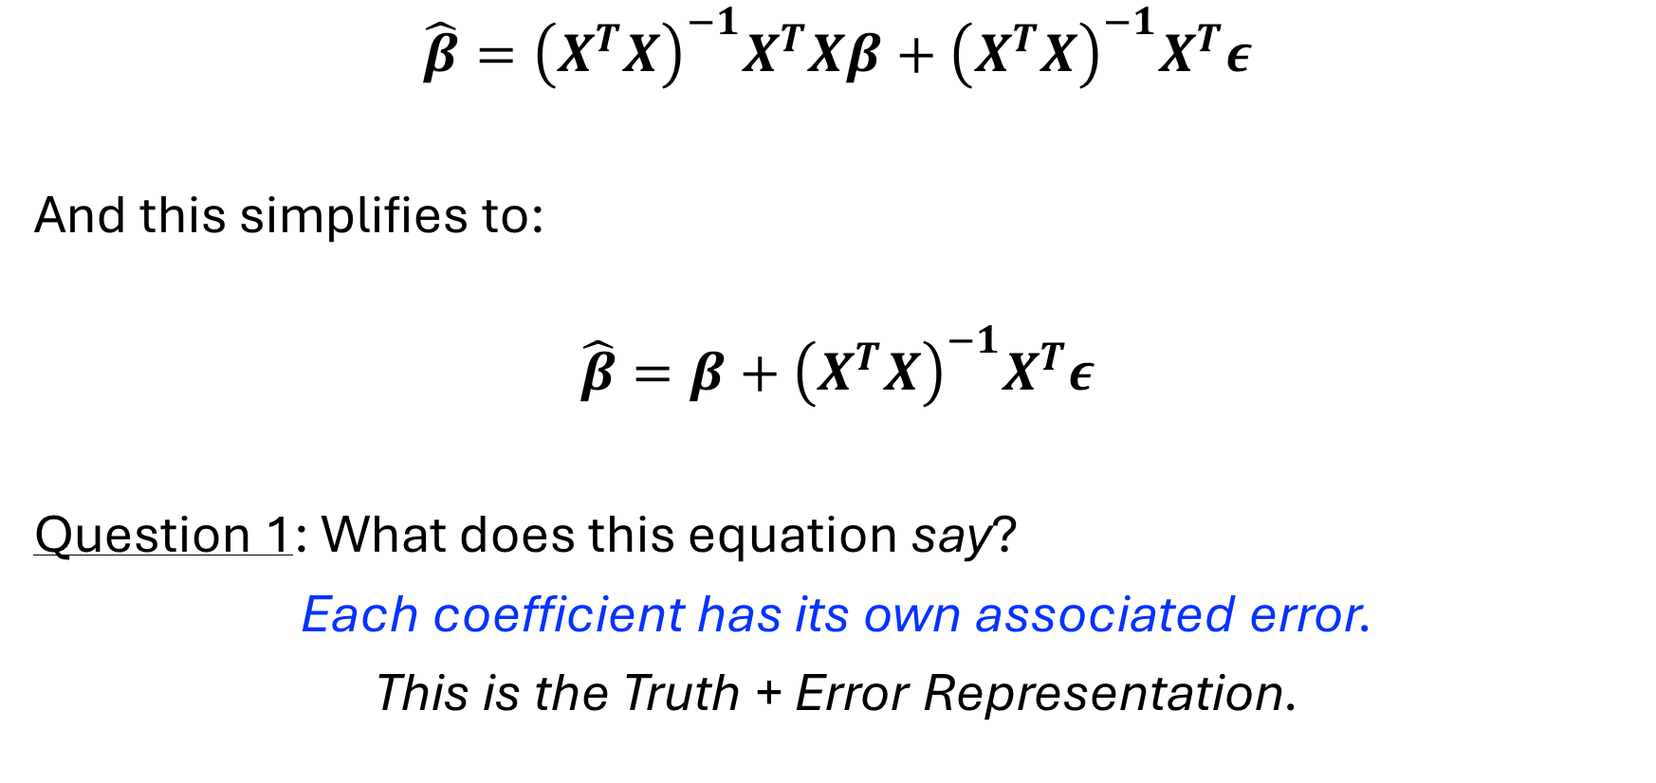
Truth + Error Representation
$$\hat{β}={\left(X^{T}X\right)}^{−1}X^{T}Xβ+{\left(X^{T}X\right)}^{−1}X^{T}ε$$
And this simplifies to:
$$\hat{β}=β+{\left(X^{T}X\right)}^{−1}X^{T}ε$$
Question 1: What does this equation say?
Each coefficient has its own associated error.
This is the Truth + Error Representation.

Slide 87
Truth + Error Representation
The Truth + Error Representation is convenient for us.
For example, we can ask our next question:
$$\hat{β}=β+{\left(X^{T}X\right)}^{−1}X^{T}ε$$
Question 2: What is the expectation of $\hat{β}$?

Slide 88
Truth + Error Representation
Question 2: What is the expectation of $\hat{β}$?
Take the Expectation of both sides:
$$\hat{β}=β+{\left(X^{T}X\right)}^{−1}X^{T}ε$$
$$→𝔼\left[\hat{β}\right]=𝔼[β+{\left(X^{T}X\right)}^{−1}X^{T}ε]$$
When can we make this the sum of expectations? Always.

Slide 89
Truth + Error Representation
Question 2: What is the expectation of $\hat{β}$?
So we get:
$$𝔼\left[\hat{β}\right]=𝔼\left[β+{\left(X^{T}X\right)}^{−1}X^{T}ε\right]$$
$$=𝔼\left[β\right]+𝔼\left[{\left(X^{T}X\right)}^{−1}X^{T}ε\right]$$

Slide 90
Recall our “Big Three” Assumptions
In order of preference / strength:
1.
2.
3.

Slide 91
Truth + Error Representation
Question 2: What is the expectation of $\hat{β}$?
So we get:
$$𝔼\left[\hat{β}\right]=𝔼\left[β+{\left(X^{T}X\right)}^{−1}X^{T}ε\right]$$
$$=𝔼\left[β\right]+𝔼\left[{\left(X^{T}X\right)}^{−1}X^{T}ε\right]$$
$$=𝔼\left[β\right]+𝔼\left[{\left(X^{T}X\right)}^{−1}X^{T}\right]𝔼\left[ε\right]$$
$$=β$$

Slide 92
Variance of $\hat{β}$
We conclude that $\hat{β}$ is unbiased.
Next we look at the variance of $\hat{β}$:
Assume $Var\left[ε\right]=σ^{2}I_{n×n}$.
We use the 2nd assumption.

Slide 93
Variance of $\hat{β}$
Assume $Var\left[ε\right]=σ^{2}I_{n×n}$.
$$\hat{β}=β+{\left(X^{T}X\right)}^{−1}X^{T}ε$$
so
$$Var[\hat{β}]=Var\left[β+{\left(X^{T}X\right)}^{−1}X^{T}ε\right]$$

Slide 94
Variance of a Linear Transformation
Recall:
$$Var\left[aY\right]=$$
An extension of this in matrix – vector form is:
$$Var\left(AY\right)=A Var\left[Y\right] A^{T}$$
where $Y$is $m × 1$ and $A$is $n × m$.

Slide 95
Variance of $\hat{β}$
Assume $Var\left[ε\right]=σ^{2}I_{n×n}$.
$$\hat{β}=β+{\left(X^{T}X\right)}^{−1}X^{T}ε$$
so
$$Var[\hat{β}]=Var\left[{\left(X^{T}X\right)}^{−1}X^{T}ε\right]$$
$$={\left(X^{T}X\right)}^{−1}X^{T}Var\left[ε\right]{\left({\left(X^{T}X\right)}^{−1}X^{T}\right)}^{T}$$

Slide 96
Variance of $\hat{β}$
Assume $Var\left[ε\right]=σ^{2}I_{n×n}$.
$$\hat{β}=β+{\left(X^{T}X\right)}^{−1}X^{T}ε$$
so
$$Var[\hat{β}]=Var\left[{\left(X^{T}X\right)}^{−1}X^{T}ε\right]$$
$$={\left(X^{T}X\right)}^{−1}X^{T}σ^{2}I_{ }{\left({\left(X^{T}X\right)}^{−1}X^{T}\right)}^{T}$$

Slide 97
Variance of $\hat{β}$
Assume $Var\left[ε\right]=σ^{2}I_{n×n}$.
$$\hat{β}=β+{\left(X^{T}X\right)}^{−1}X^{T}ε$$
so
$$Var[\hat{β}]=Var\left[{\left(X^{T}X\right)}^{−1}X^{T}ε\right]$$
$$=σ^{2}{\left(X^{T}X\right)}^{−1}X^{T}{\left({\left(X^{T}X\right)}^{−1}X^{T}\right)}^{T}$$

Slide 98
Variance of $\hat{β}$
Assume $Var\left[ε\right]=σ^{2}I_{n×n}$.
$$\hat{β}=β+{\left(X^{T}X\right)}^{−1}X^{T}ε$$
so
$$Var[\hat{β}]=Var\left[{\left(X^{T}X\right)}^{−1}X^{T}ε\right]$$
$$={σ^{2}\left(X^{T}X\right)}^{−1} X^{T}X{{\left(X^{T}X\right)}^{−1}}^{T}$$

Slide 99
Variance of $\hat{β}$
Assume $Var\left[ε\right]=σ^{2}I_{n×n}$.
$$\hat{β}=β+{\left(X^{T}X\right)}^{−1}X^{T}ε$$
so
$$Var[\hat{β}]=Var\left[{\left(X^{T}X\right)}^{−1}X^{T}ε\right]$$
$$={σ^{2}\left(X^{T}X\right)}^{−1}$$

Slide 100
Variance of $\hat{β}$
Assume $Var\left[ε\right]=σ^{2}I_{n×n}$.
$$\hat{β}=β+{\left(X^{T}X\right)}^{−1}X^{T}ε$$
so
$$Var[\hat{β}]=Var\left[{\left(X^{T}X\right)}^{−1}X^{T}ε\right]$$
$$={σ^{2}\left(X^{T}X\right)}^{−1}$$
What does this mean?

Slide 101
Takeaways for $\hat{β}$ continued
$$\hat{β}=β+{\left(X^{T}X\right)}^{−1}X^{T}ε$$
We conclude that $\hat{β}$ is unbiased.
We have the proportion
$$Var[\hat{β}]={σ^{2}\left(X^{T}X\right)}^{−1}$$
What about the distribution of $\hat{β}$?

Slide 102
Distribution of $\hat{β}$
$$\hat{β}=β+{\left(X^{T}X\right)}^{−1}X^{T}ε$$
Third assumption:
Then, since $\hat{β}$ is a linear transformation of $ε,$
$\hat{β}\sim$

Slide 103
Takeaways

Slide 104
The Residual Vector
Let’s establish similar properties for the residual vector $e={\left[e_{1},…,e_{n}\right]}^{T}$.
$$e=Y−\hat{Y}=Xβ+ε−X\hat{β}$$
$e={\left[e_{1},…,e_{n}\right]}^{T}$ is a compact way of writing $e=\left[\begin{matrix}e_{1} \\ ⋮ \\ e_{n}\end{matrix}\right]$

Slide 105
The Residual Vector
Using the truth + error representation:
$$e=Xβ−X\hat{β}+ε$$
$$=Xβ−X\left(β+{\left(X^{T}X\right)}^{−1}X^{T}ε\right)+ε$$

Slide 106
The Residual Vector
Using the truth + error representation:
$$e=Xβ−X\hat{β}+ε$$
$$=Xβ−X\left(β+{\left(X^{T}X\right)}^{−1}X^{T}ε\right)+ε$$
$$=Xβ−Xβ−X{\left(X^{T}X\right)}^{−1}X^{T}ε+ε$$

Slide 107
The Residual Vector
Using the truth + error representation:
$$e=Xβ−X\hat{β}+ε$$
$$=Xβ−X\left(β+{\left(X^{T}X\right)}^{−1}X^{T}ε\right)+ε$$
$$=ε−X{\left(X^{T}X\right)}^{−1}X^{T}ε$$

Slide 108
The Residual Vector
Using the truth + error representation:
$$e=Xβ−X\hat{β}+ε$$
$$=Xβ−X\left(β+{\left(X^{T}X\right)}^{−1}X^{T}ε\right)+ε$$
$$=ε−Hε$$

Slide 109
The Residual Vector
Using the truth + error representation:
$$e=Xβ−X\hat{β}+ε$$
$$=Xβ−X\left(β+{\left(X^{T}X\right)}^{−1}X^{T}ε\right)+ε$$
$$=Iε−Hε$$
* You can’t stop me from multiplying a vector by $I.$

Slide 110
The Residual Vector
So we have:
$$e=\left(I−H\right)ε$$
Another fact: If $H$is an orthogonal projection (______________ and _____________), then so is $I−H$.

Slide 111
Quick Tangent
Let’s show that $I−H$ is an orthogonal projection.

Slide 112
The Residual Vector
$$e=\left(I−H\right)ε$$
Therefore:
First assumption on $ε$:
So $𝔼\left[e\right]=$

Slide 113
The Residual Vector
$$e=\left(I−H\right)ε$$
Therefore:
Second assumption on $ε$:
So $Var\left[e\right]= Var\left[\left(I−H\right)ε\right]$
$=$

Slide 114
The Residual Vector
$$e=\left(I−H\right)ε$$
Therefore:
Second assumption on $ε$:
So $Var\left[e\right]=\left(I−H\right) Var\left[ε\right]{\left(I−H\right)}^{T}$
$=$

Slide 115
The Residual Vector
$$e=\left(I−H\right)ε$$
Therefore:
Third assumption on $ε$:
So $e\sim$

Slide 116
The Residual Vector
These results suggest that we can verify modeling assumptions by looking at properties of the residuals.
$e$has mean zero for each $x$ suggests $ε$ has mean zero.
$e$is homoskedastic suggests $ε$ has constant variance $σ^{2}$.
$e is approx.$ normally distributed suggests $ε\sim N(0,σ^{2})$.

Slide 117
The Takeaways
We can look at the behavior of the coefficients $\hat{β}$.
They are unbiased estimators of the true (unknown) $β$.
We can use the residuals to estimate the variance of $β.$
This means: We can meaningfully estimate how far off of $β$ we are.
We can look at the residuals and it will tell us whether we truly meet the assumptions we’ve made.
These are called diagnostics. We are doing a “health check” of the assumptions by looking at the residuals.

Slide 118
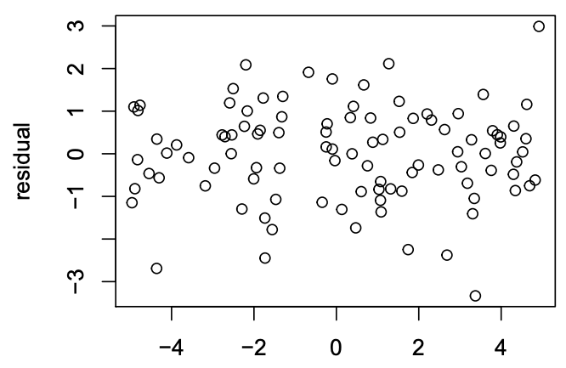
Examples

Slide 119
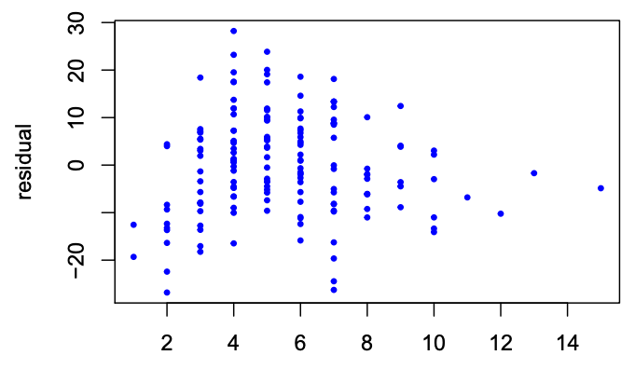
Examples

Slide 120
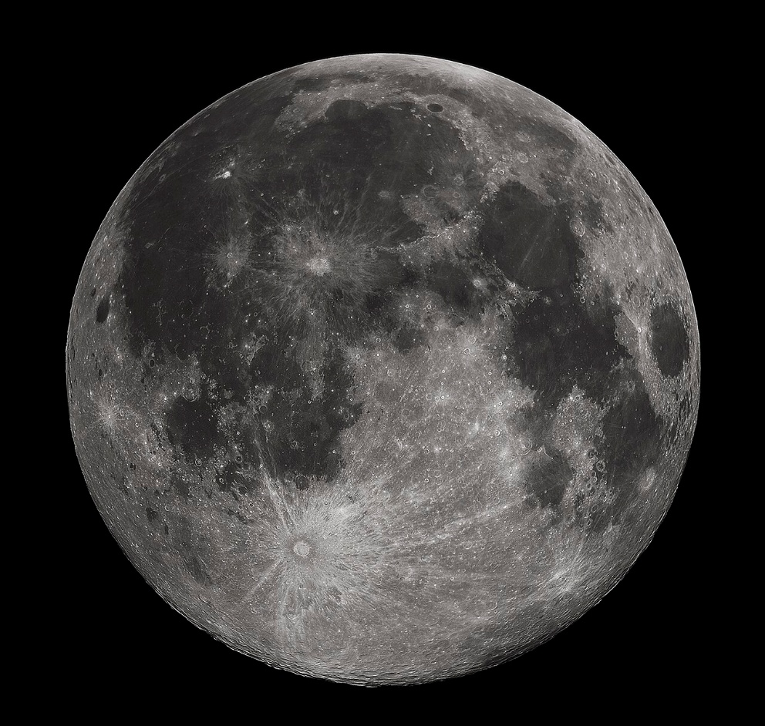
The Moon Motion Problem
The Moon is tidally locked… but not perfectly.
The Moon “wobbles” in three ways:
Longitude
Latitude
Diurnal
So we can actually see approximately 59% of the near side of the moon (vice 50% with a perfect tidal lock.)
By Gregory H. Revera, CC BY-SA 3.0, https://commons.wikimedia.org/w/index.php?curid=11901243

Slide 121
The Moon Motion Problem
Tobias Mayer (1723-1762) collected data to describe this wobbling motion of the moon, libration, as a linear function of two variables.
He collected 27 measurements total, placed into 3 groups of 9 measurements each.
His objective was to solve for the coefficients in the linear function.

Slide 122
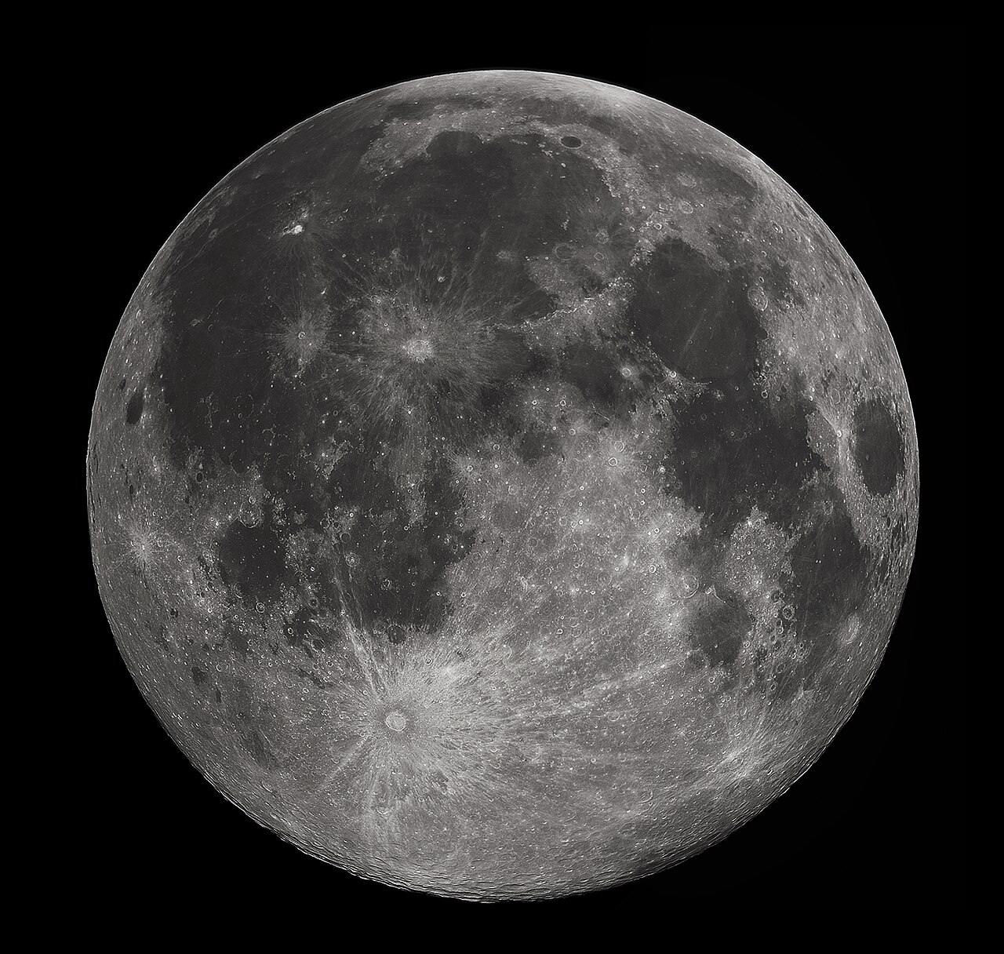
Mayer’s Equation
Given
$Y≔$ arc (libration)
$x_{1}≔sin$of a key angle relative to the Manilius crater
$x_{2}≔\cos{ }$of of a key angle relative to the Manilius crater
$$Y=β+αx_{1}+γx_{2}+ε$$
Objective: Solve for $β, α,$and $γ$.
By Gregory H. Revera, CC BY-SA 3.0, https://commons.wikimedia.org/w/index.php?curid=11901243

Slide 123
Bivariate Model
With two predictors and a single response, we project the arc data $Y$ onto a 2-dimensional plane.
As we expect from an overdetermined set of data, not all 27 points lie on the plane.
Each data point has an associated distance (in the direction of $Y$) from the regression plane.

Slide 124
What Gives?!
This does not look “linear.”
$\sin{θ_{ }}$and $\cos{φ}$ aren’t linear functions
So how do we define linear?

Slide 125
From Linear Algebra
We can define a basis any way we want to*, as long as:
Scalar multiplication behaves properly
Addition behaves properly
Recall the basis is just a set of directions that can uniquely describe every vector in the space.
Ex:
The standard basis.
The polynomial basis.
Therefore, a linear model is one that incorporates a linear relationship among the parameters ${\hat{β}}_{0},{\hat{β}}_{1},…,{\hat{β}}_{p}$, not of $x_{i}$
*I call this a cousin of “You can’t stop me…”

Slide 126
Which of These Models is Linear?
$β_{0}+β_{1}x$
$β_{0}+β_{1}x+β_{2}x^{2}+β_{3}x^{3}$
$β_{0}x^{β_{1}}$
$β_{0}+β_{1}x_{1}+β_{0}β_{1}x_{1}^{2}$
$\frac{1}{β_{0}+β_{1}x}$
$\frac{e^{β_{0}+β_{1}x}}{1+e^{β_{0}+β_{1}x}}$
$β_{1}\sin\left(x\right)+β_{2}\cos\left(x\right)+β_{3}\sin\left(x\right)\cos\left(x\right)$
$β_{0}+β_{1}x_{1}+β_{2}x_{2}+β_{3}x_{1}x_{2}$

Slide 127
How can we tell “at a glance”?
Look at the design matrix $X$ and parameters $\hat{β}$.
Ex: $β_{0}+β_{1}x+β_{2}x^{2}+β_{3}x^{3}$

Slide 128
Design Matrix View
If the model can be written as
$$Y=Xβ+ε$$
it is linear.
Example:
$$X=\left[\begin{matrix}1 & x_{11} & x_{21} & x_{11}x_{21} \\ 1 & x_{12} & x_{22} & x_{12}x_{22} \\ ⋮ & ⋮ & ⋮ & ⋮ \\ 1 & x_{1n} & x_{2n} & x_{1n}x_{2n}\end{matrix}\right] \hat{β}=\left[\begin{matrix}{\hat{β}}_{0} \\ {\hat{β}}_{1} \\ {\hat{β}}_{2} \\ {\hat{β}}_{3}\end{matrix}\right]$$

Slide 129
Mayer’s Equation
Given
$Y≔$ arc (libration)
$x_{1}≔sin$of a key angle relative to the Manilius crater
$x_{2}≔\cos{ }$of of a key angle relative to the Manilius crater
$$Y=β+αx_{1}+γx_{2}+ε$$
Objective: Solve for $β, α,$and $γ$.
By Gregory H. Revera, CC BY-SA 3.0, https://commons.wikimedia.org/w/index.php?curid=11901243

Slide 130
Transformations
This gives us a powerful tool for fitting our data to more realistic models.
$$Y=β+αx_{1}+γx_{2}+ε$$
$Y≔$ arc
$x_{1}≔sin θ$
$x_{2}≔\cos{φ }$

Slide 131
Better Fitting Models
This opens up many more possibilities of modeling the relationship of our data with a linear model.
We can examine the residual behavior from our Truth+Error discussion to help us decide what a “better” model is.

Slide 132
The Residual Vector
We can verify modeling assumptions by looking at properties of the residuals.
$e$has mean zero for each $x$ suggests $ε$ has mean zero.
$e$is homoskedastic suggests $ε$ has constant variance $σ^{2}$.
$e is approx.$ normally distributed suggests $ε\sim N(0,σ^{2})$.
If $e$doesn’t meet these conditions, we can try to update our predictors.

Slide 133
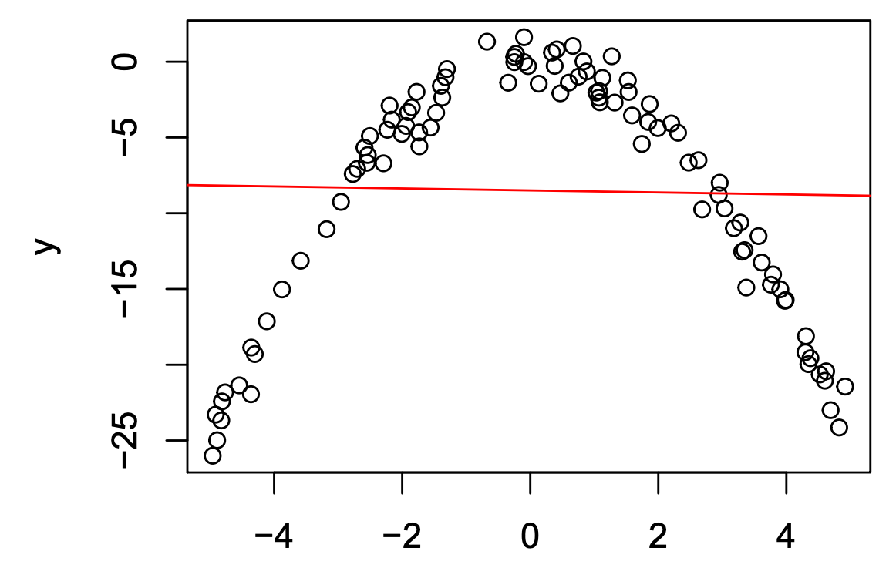
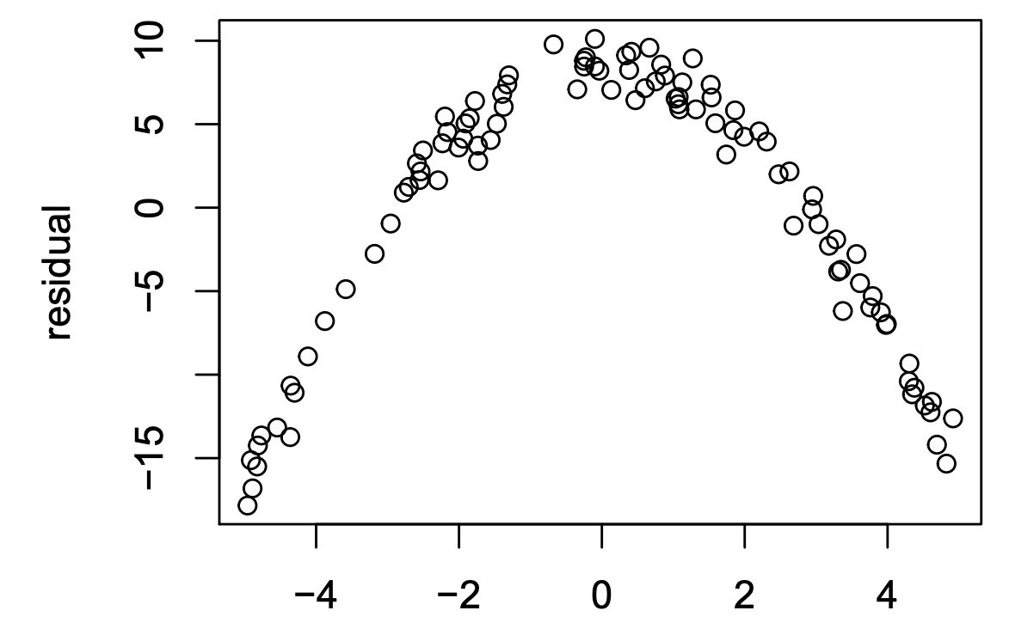
Example

Slide 134
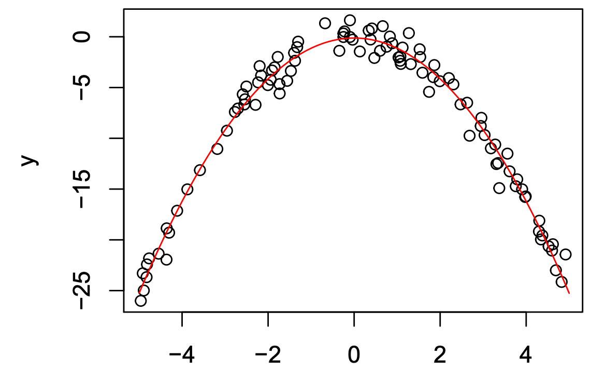
Example

Slide 135
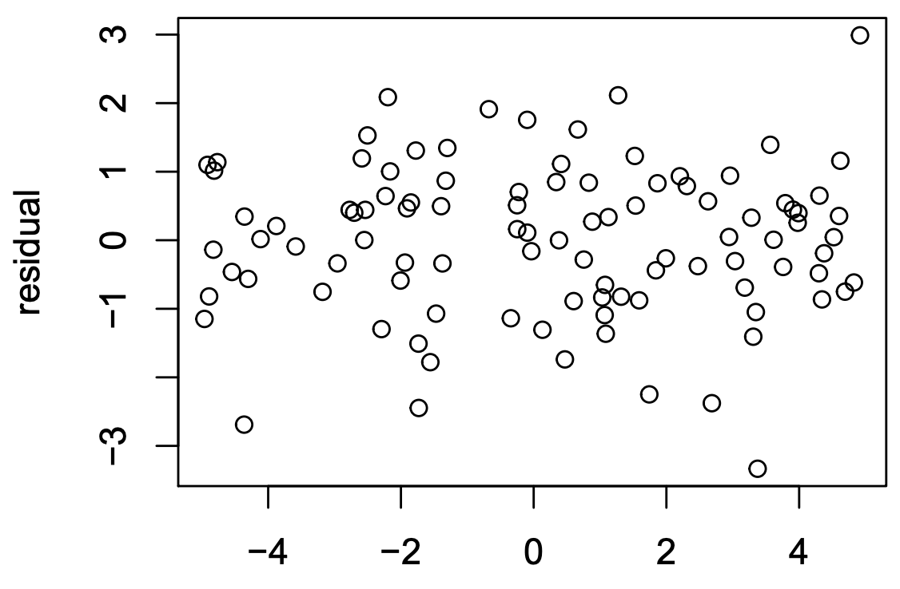
Example

Slide 136
Better Fitting Models
This opens up many more possibilities of modeling the relationship of our data with a linear model.
We can examine the residual behavior from our Truth+Error discussion to help us decide what a “better” model is.
Use this along with Test MSE to compare models.

Slide 137
Residual Analysis
The Idea:
Suppose our residuals are bad. What can we do about it?
Transform the predictors and/or the response.

Slide 138
Examples

Slide 139
Examples

Slide 140
Residual Analysis
The Idea:
Suppose our residuals are bad. What can we do about it?
Add interactions of variables.
We will discuss this in a separate lecture.

Slide 141
Residual Analysis
The Idea:
Suppose our residuals are bad. What can we do about it?
Admit defeat.
There a few more niche tools to try out.
Step back and realize what this is telling us.

Slide 142
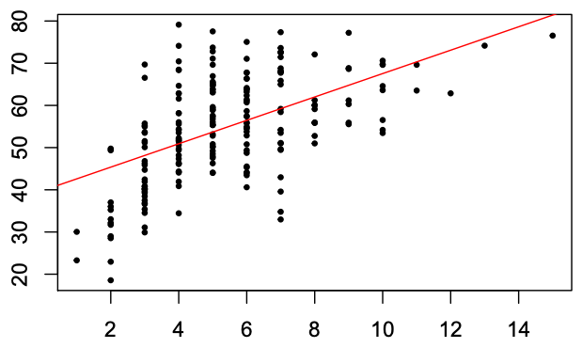
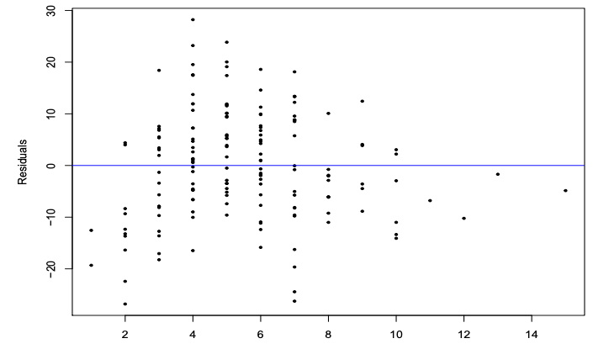
Example: A Linear Fit

Slide 143
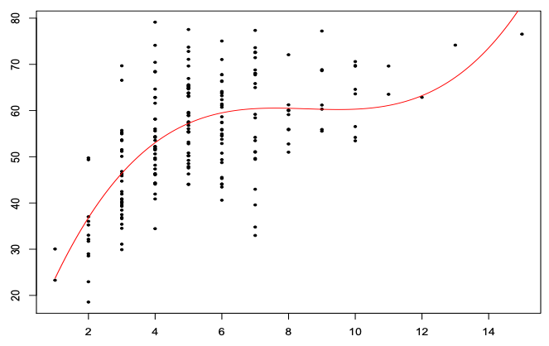
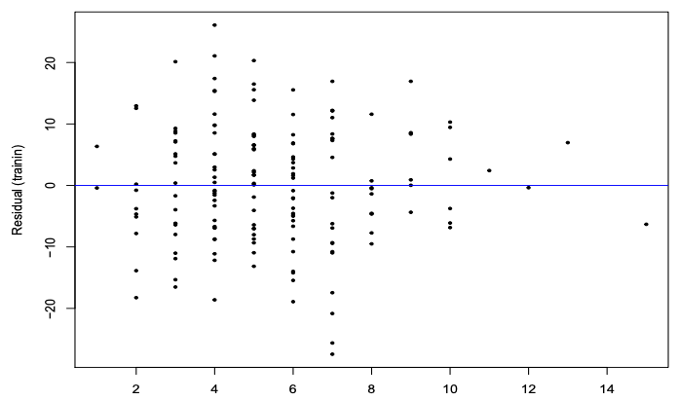
Example: A 3rd Deg Polynomial Transformation

Slide 144
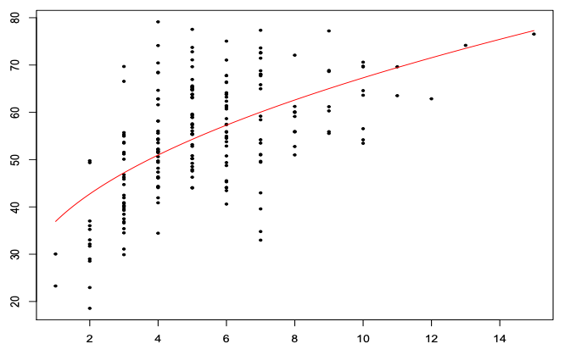
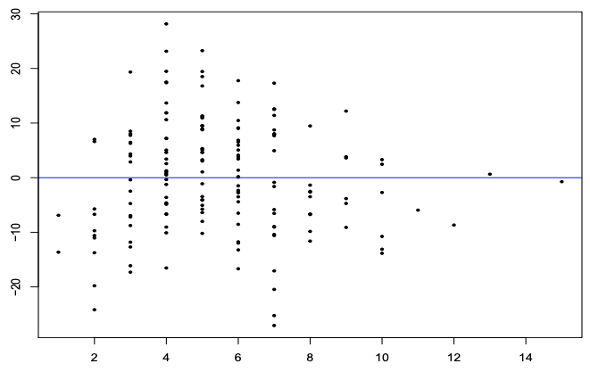
Example: A Square Root Transformation

Slide 145
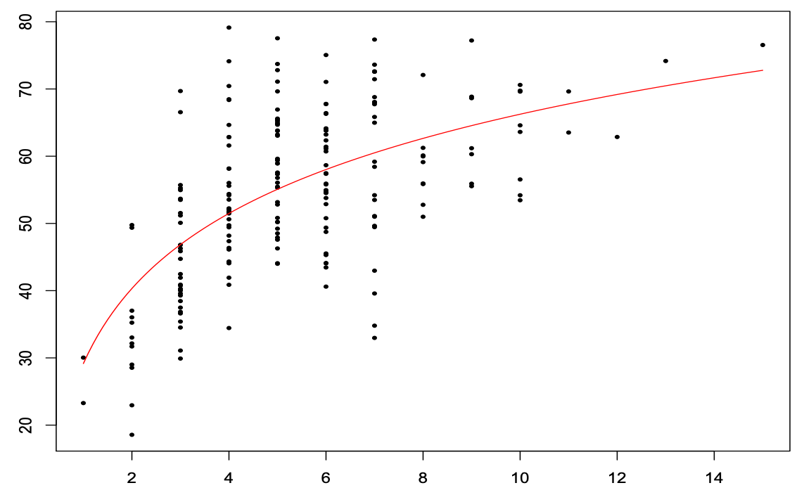
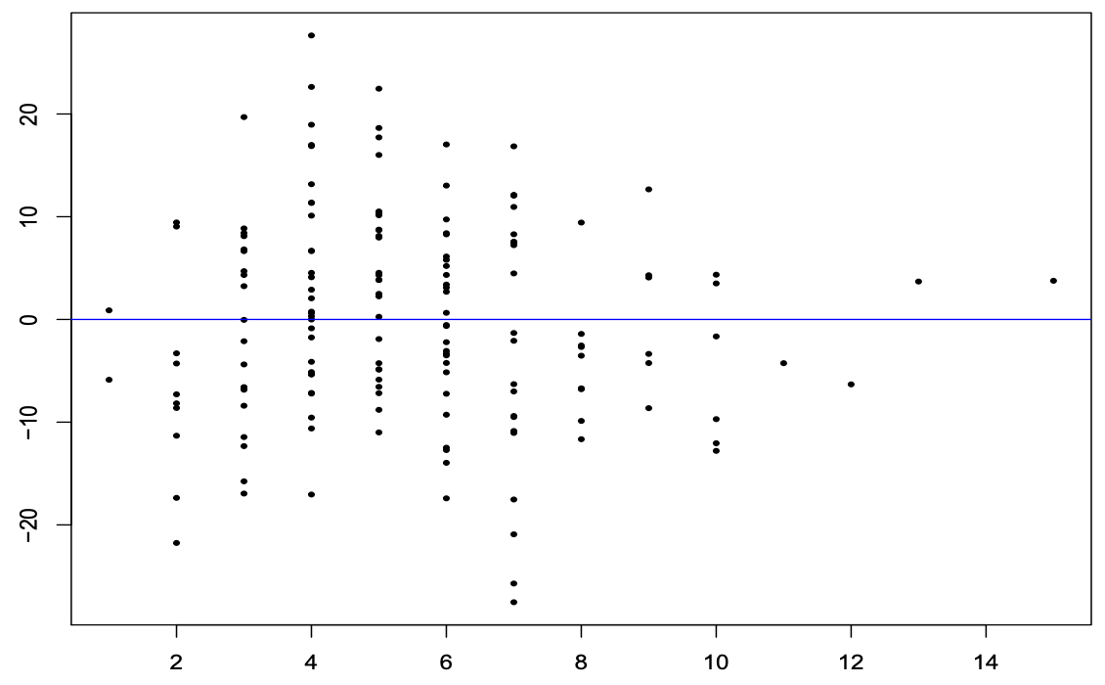
Example: A Logarithmic-Linear Transformation

Slide 146
Which One Wins?
There is a little bit of qualitative (read: subjective) analysis.
Use some of the intuition built during EDA.
We have other tools to help justify our analyses.
Be wary of taking a single hypothesis test in a vacuum.

